Slide 1
BANKRUPTCY

Slide 2
Problem statement & OVERVIEW
This is a classification project, since the variable to predict is binary (bankruptcy or non-bankruptcy). The goal here is to model the probability that a business goes bankrupt from different features.
The project aims to predict the probability of a business going bankrupt based on various features. We've gathered a dataset containing financial and operational metrics of businesses, which serve as the features for our model. Our initial data preprocessing and exploratory data analysis (EDA) have provided insights into feature importance and correlations. Several classification algorithms are being evaluated, including logistic regression, decision trees, and random forest.

Slide 3
collaborators
K.Sai Shruthi
Syed Farhanuddin
P Ranganath Swamy
Vyankatesh Magnur

Slide 4
Module division
Data Collection and Preprocessing
Exploratory Data Analysis (EDA)
Model Building
Model Evaluation
Deployment
Challenges and Solutions

Slide 5
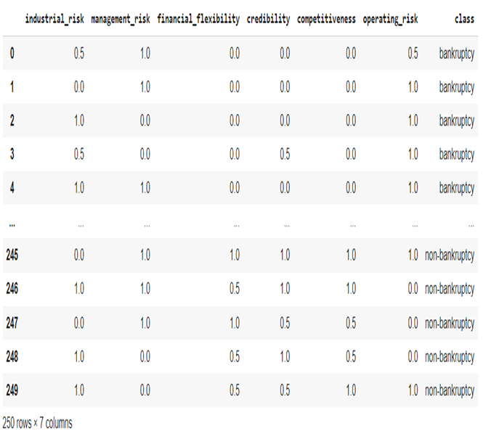
Data Collection and Preprocessing
In Machine Learning, the Classification is a predictive modeling algorithm where the class label is anticipated for a specific example of input data. It requires training data with a large number of datasets of input and output.
The data is accessed or collected through Pandas library and processed to determine the shape, size or statistics, as per requirements.
This can be used for determining handwriting characters, identifying spam, and so on.

Slide 6
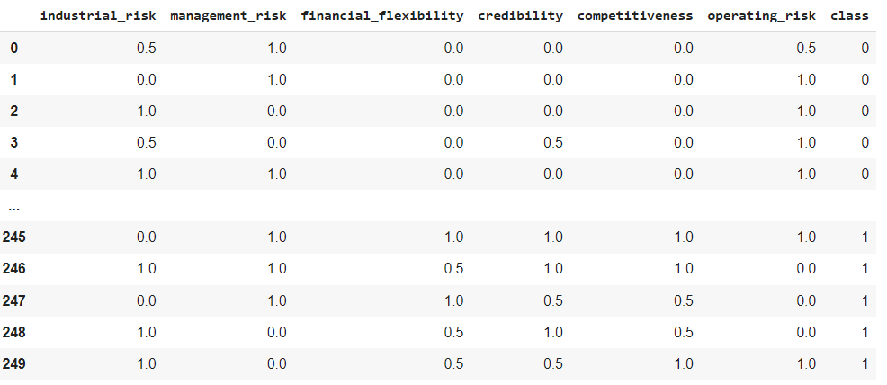
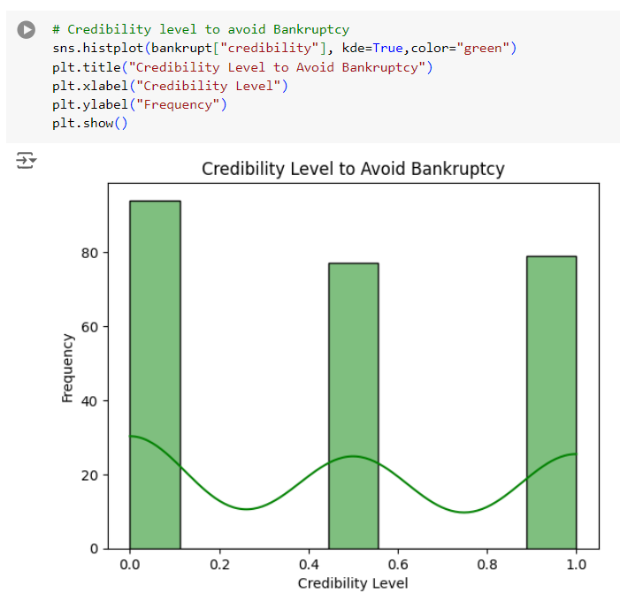
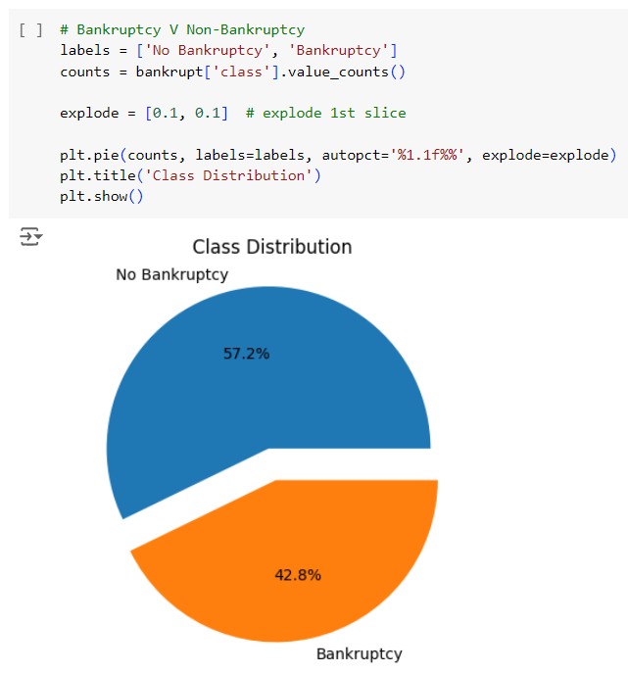
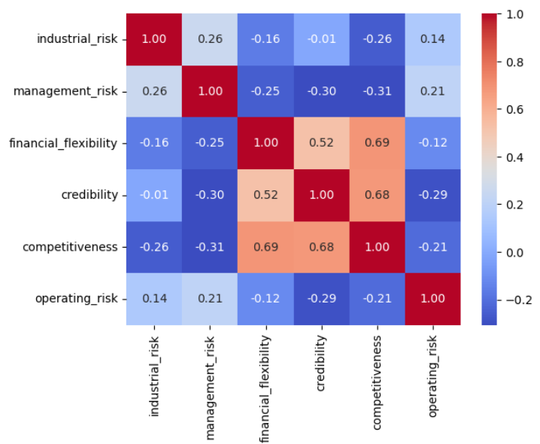

Exploratory Data Analysis (EDA)
Feature Engineering & analysis of individual features in correlation
Correlation heatmap & other visualizations

Slide 7
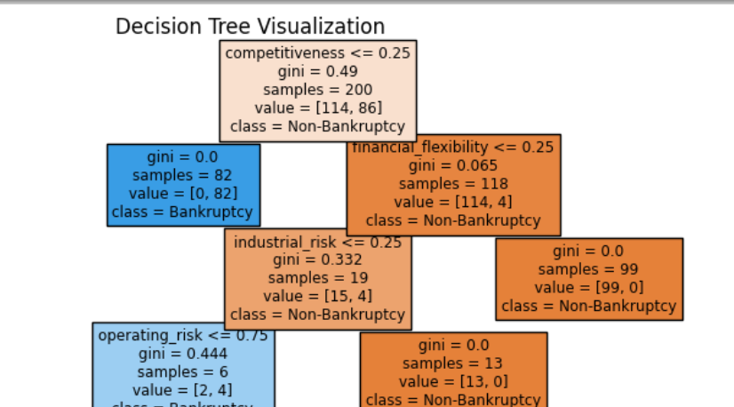
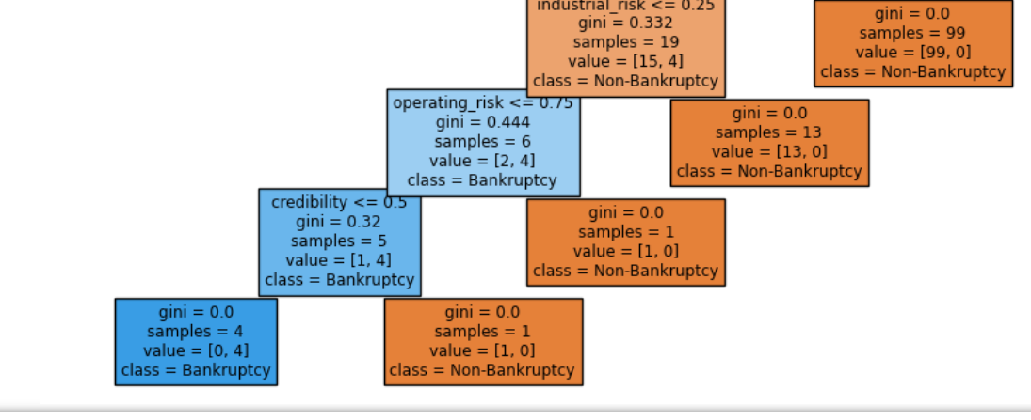
Model Building
For the classification project of modelling the probability of a business going bankrupt, we leveraged several algorithms, one of which is as follows.
Decision Tree Classification technique is based on graphical representation of the attributes; it is a tree structure similar to a flowchart. A simple form of hierarchical partitioning of dataset, makes it easier to interpret and understand the result.

Slide 8
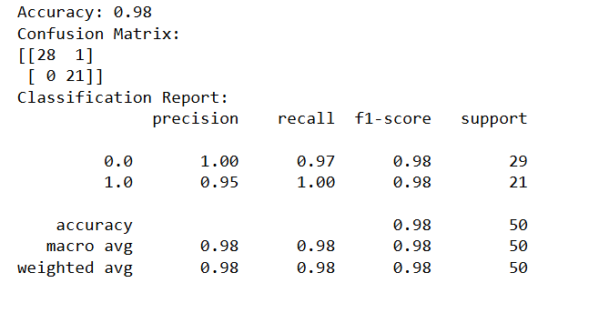
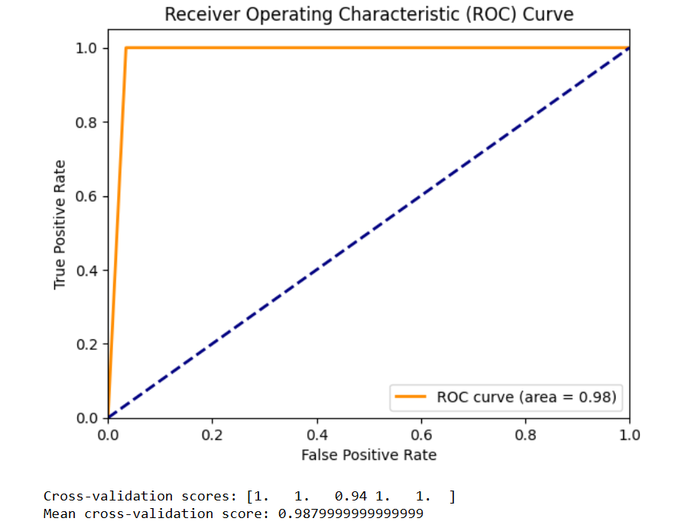
MODEL PERFORMANCE EVALUATION
We performed model evaluation based on some of the evaluation metrics. They include:
Accuracy: measure of how often a model correctly predicts the target variable.
Confusion Matrix: table used to evaluate the performance of a classification model.
Classification Report: summary of classification performance metrics.
ROC Curve: understands the overall performance of the model.

Slide 9
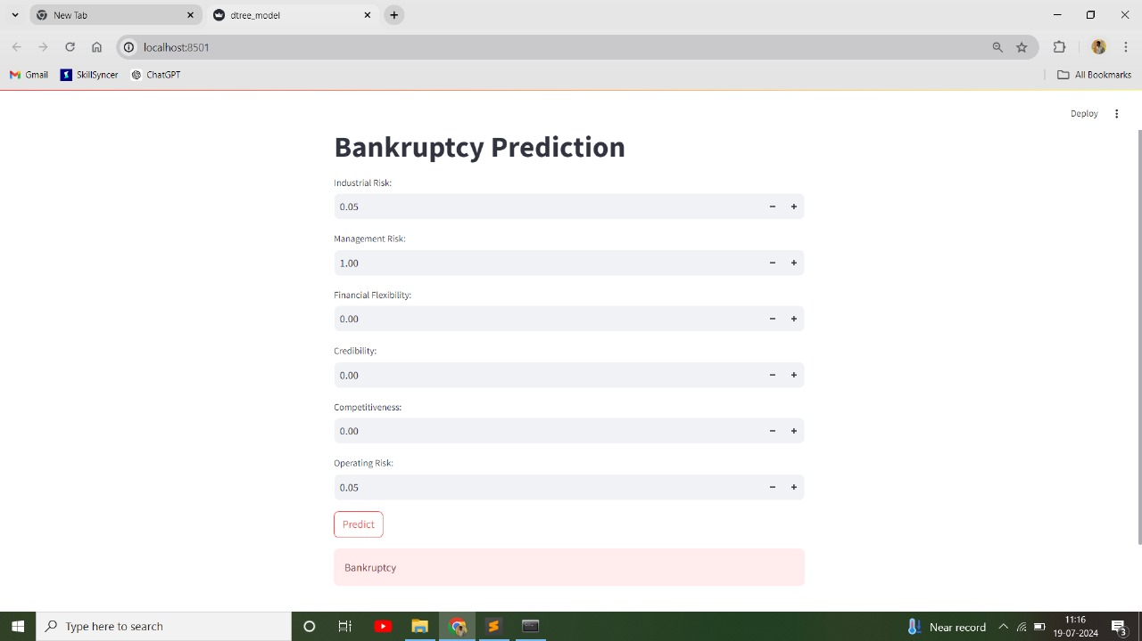
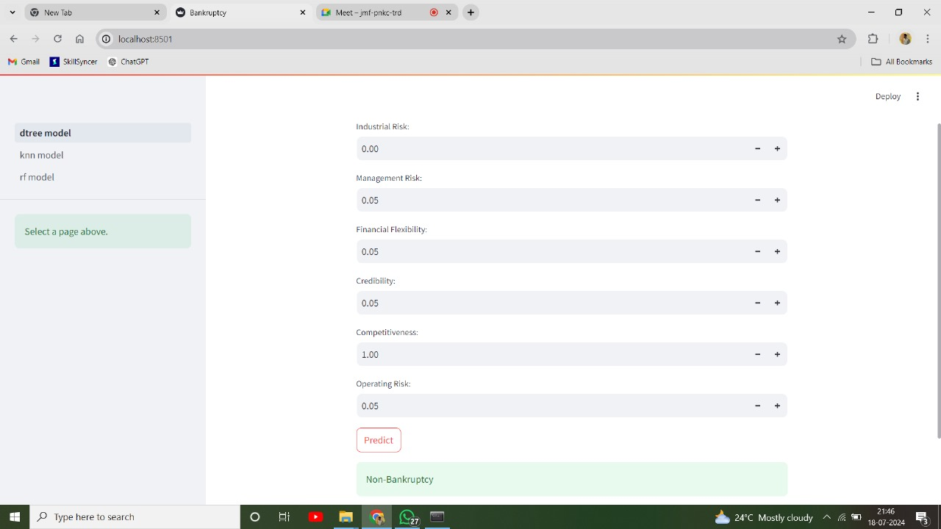
deployment
Outcome when risks are valued or are high
Outcome when required factors are valued and risks are low

Slide 10
Challenges Faced and Potential Solutions
Data Imbalance
Challenge: The dataset is highly imbalanced and unstructured, with significantly more non-bankrupt businesses than bankrupt ones.
Potential Solutions: Implementing re-sampling techniques.
Model Overfitting
Challenge: Some models tend to overfit, capturing noise rather than the
underlying pattern.
Potential Solutions: Implement regularization techniques, Ex. Cross-Validation.

Slide 11
Thank you

